Slide 1
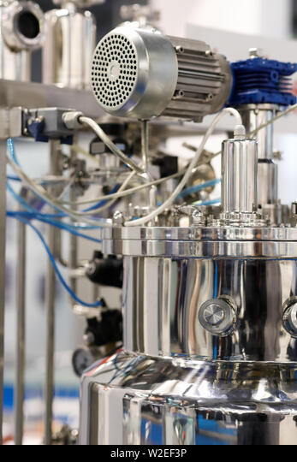

SRI LALITHA ENGINEERING

Slide 2


VERY PERI
SRI LALITHA ENGINEERING
#LOCATED AT:
IDA PASHAMYLARAM PATANCHERU MANDAL
SANGAREDDY DISTRICT, TELANGANA, INDIA.
#IN WELL VENTILATED CLOSED SHED TO OVER COME ALL CLIMATIC CONDITIONS
#PLOT NO:73, PHASE – III, IDA PASHAMYLARAM
Patancheru Mandal, Sangareddy Dist,
TELANGANA - 502307

Slide 3

ABOUT US:
SRI LALITHA ENGINEERING was established in MAY 2018
Site measures about half acre
We are manufacturing all chemical plant equipments
SRI LALITHA ENGINEERING

Slide 4
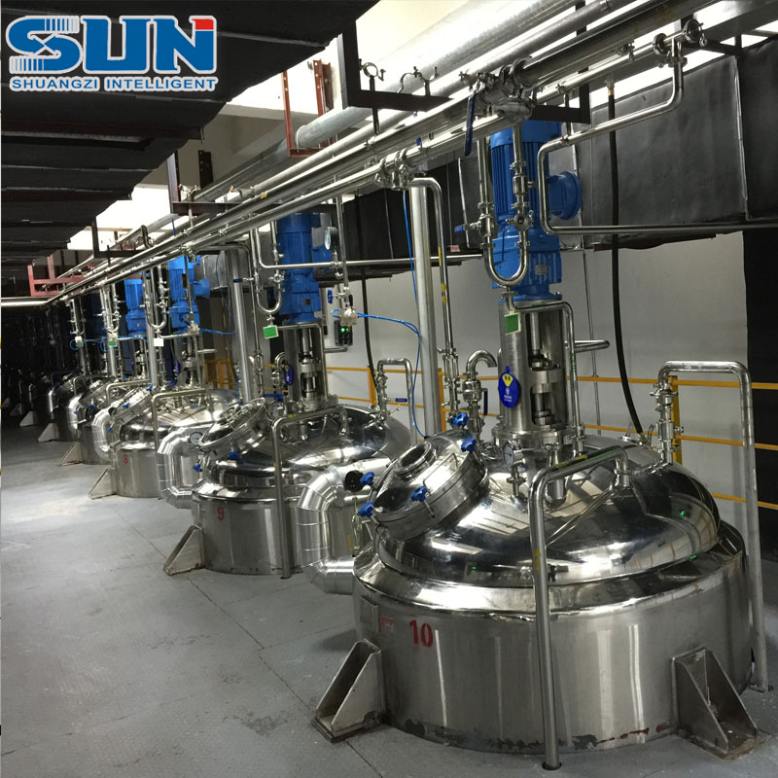
EQUIPMENTS MANUFACTURING
EQUIPMENTS MANUFACTURING:
SS 316/SS304/MS REACTORS
SS 316/SS304/MS RECEIVERS
SS 316/SS304/MS HEAT EXCHANGERS
SS316/SS304/ LEAF FILTERS
SS316/SS304/ NUTCH FILTERS
SS316/SS304/MS STORAGE TANKS
SS316/SS304/ DISTILATION COLUMNS
SS316/SS304/ PRESSURE NUTCH FILTERS
SS 316/SS304/ cGMP REACTORS
SRI LALITHA ENGINEERING

Slide 5

List of Equipments:
EOT CRANE 10T 1NO
TIG WELDING MACHINES 6 NOS
MIG WELDING MACHINES 2NOS
ARC WELDING MACHINES 5NOS
PLASMA CUTTING MACHINE 1NO
GAS CUTTING SET 2SETS
SHEET ROLLING MACHINE 1NO
LATHE MACHINE 12” 2NOS
RADIAL DRILLING MACHINE 2NOS
SLOTTING MACHUNE 1NO
SRI LALITHA ENGINEERING

Slide 6

DOCUMENTATION:
We provide all necessary documents along with the equipment
Guarantee Certificate
Material test certificates
Drawings of the equipment
Hydraulic test reports
Dimensional report
Manuals etc.
SRI LALITHA ENGINEERING

Slide 7

MANPOWER:
ENGINEER 2 No
SKILLED WORKERS 20 NOS
SEMI SKILLED WORKERS 9 NOS
UNSKILLED WORKERS 4 NOS
SRI LALITHA ENGINEERING

Slide 8
our clients:
MSN LIFE SCIENCES PVT LTD MSN LABORATORIES PVT LTD MAITHRI LABORATORIES PVT LTD MSN PHARMACHEM PVT LTD RAMPEX LABS PVT LTD VANAMALI ORGANICS PVT LTD ENPIAR PHARMA PVT LTD ERITHRO PHARMA PVT LTD S K IMPORTS AND EXPORTS METROCHEM API PVT LTD SAHITI DRUGS & INTERMEDIATES PVT LTD RISHON LABORATORIES PVT LTD VLINE PHARMACHEM PVT LTD DYNARX TECHNOLOGY INDIA ADITYA MEDI PHARMA PVT LTD STARKER LTD (RUSSIA) SYNTHO CHIRALS PVT ADAARSH PHARMACON INDUSTRIES PVT LTD
SRI LALITHA ENGINEERING

Slide 9

CONTACT DETAILS
CONTACT DETAILS:
RAMA RAJU - 9885713999
9989785588
Mail: srilalithaengineering1@gmail.com info@srilalithaengineering.com
Website: srilalithaengineering.com
SRI LALITHA ENGINEERING

Slide 10
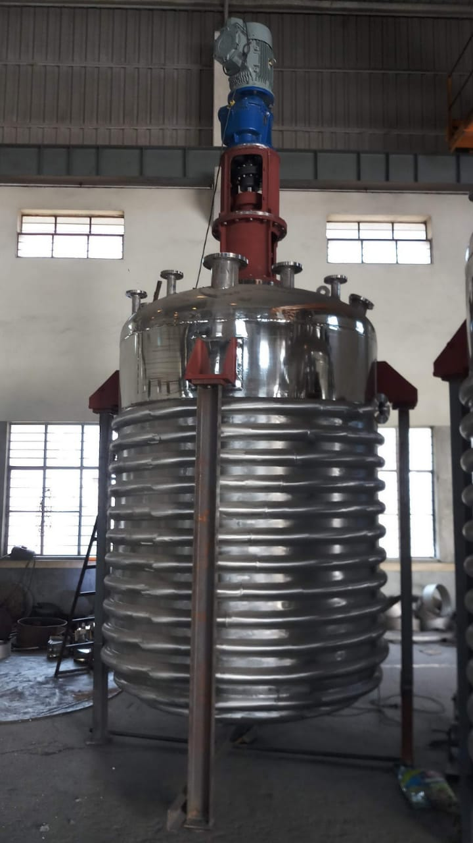
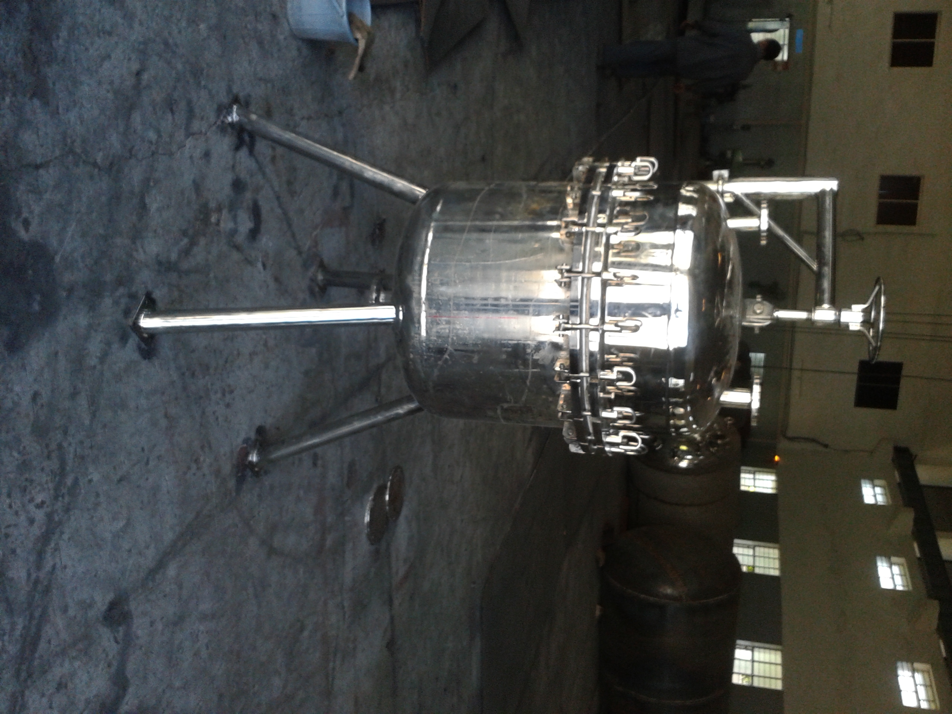
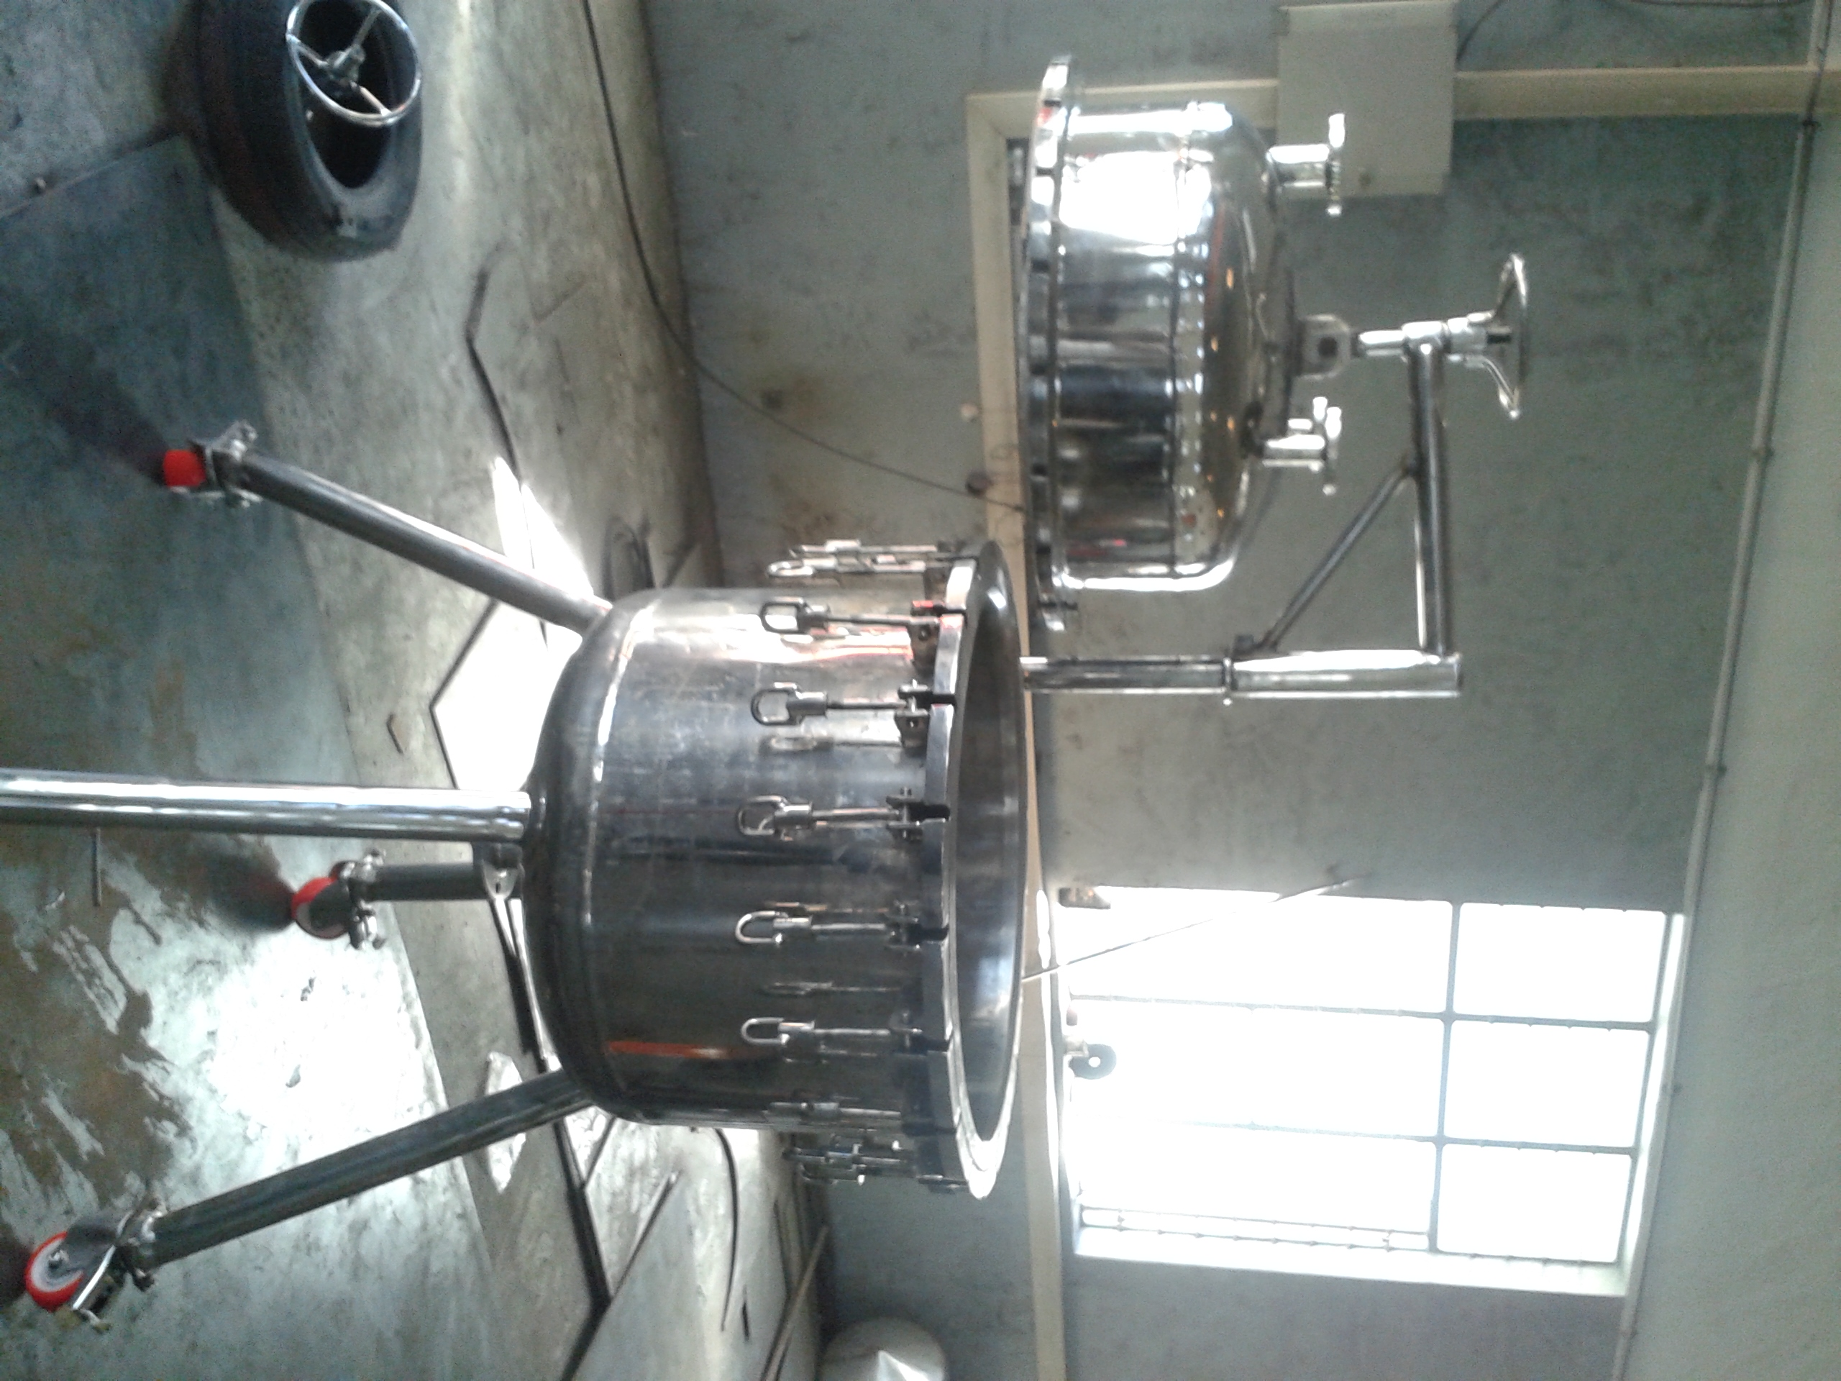
SRI LALITHA ENGINEERING

Slide 11
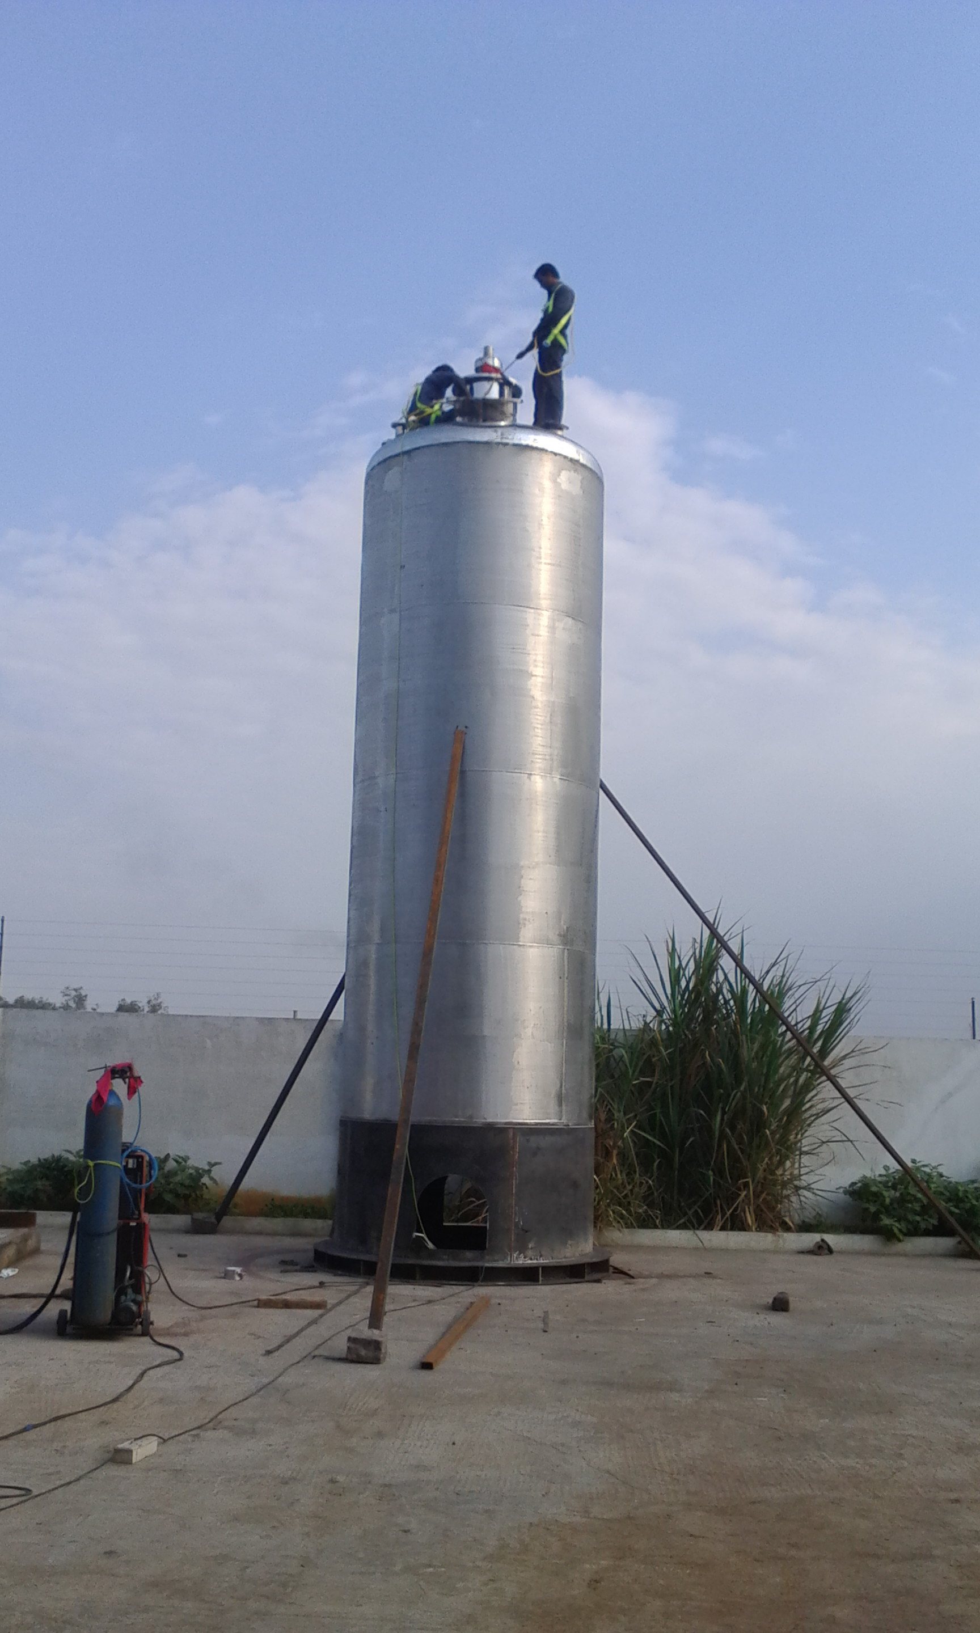
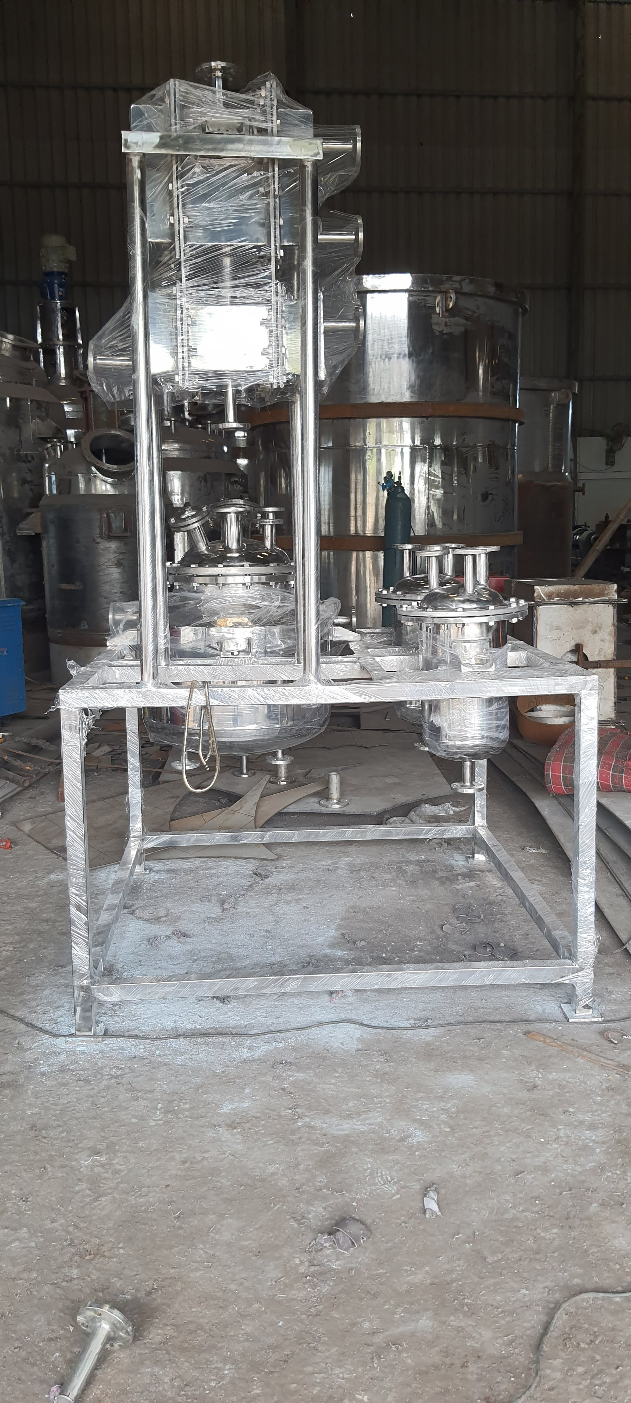
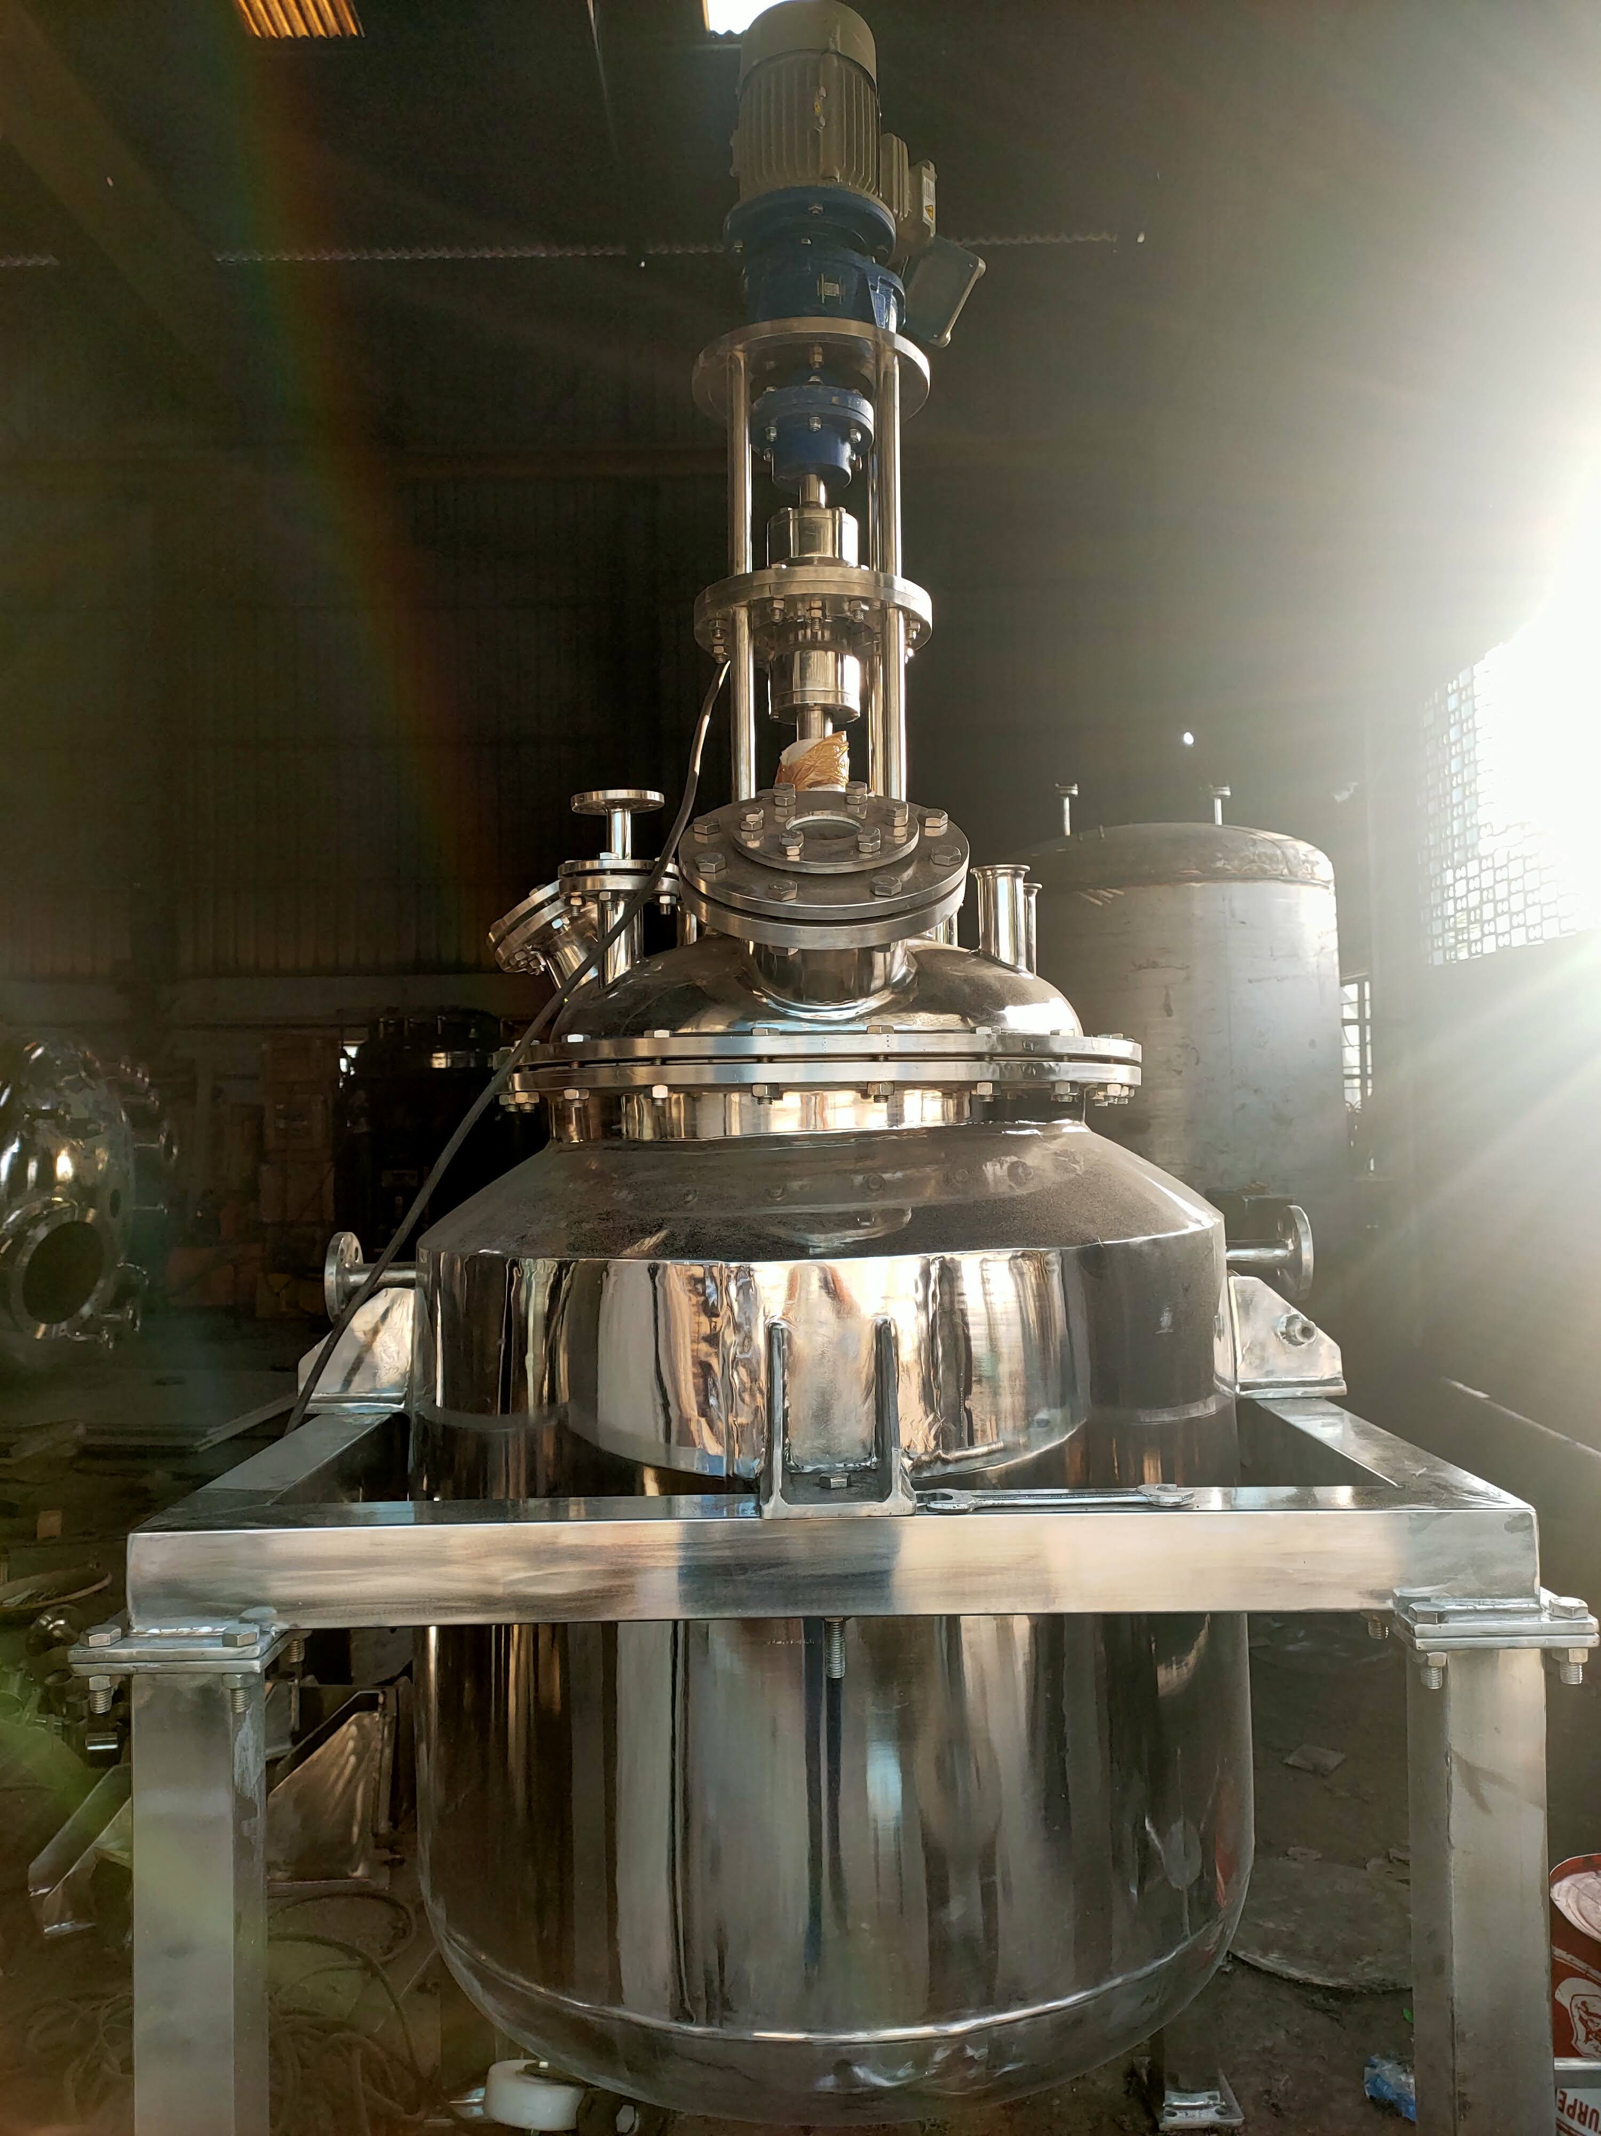
SRI LALITHA ENGINEERING

Slide 12
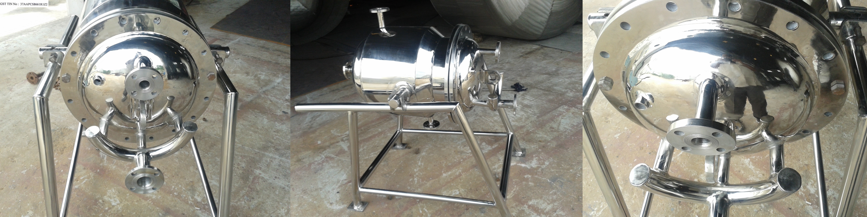
SRI LALITHA ENGINEERING

Slide 13
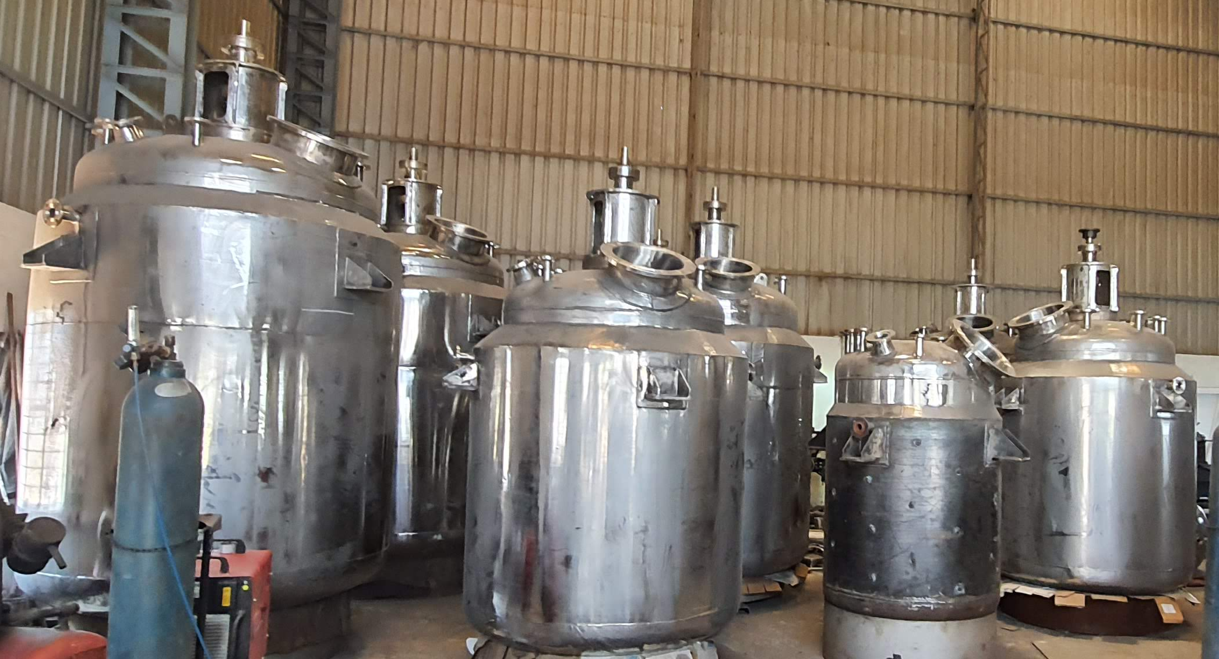
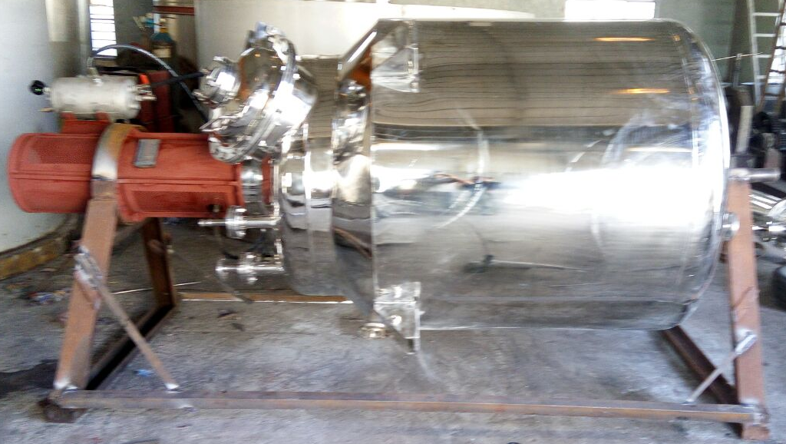
SRI LALITHA ENGINEERING

Slide 14
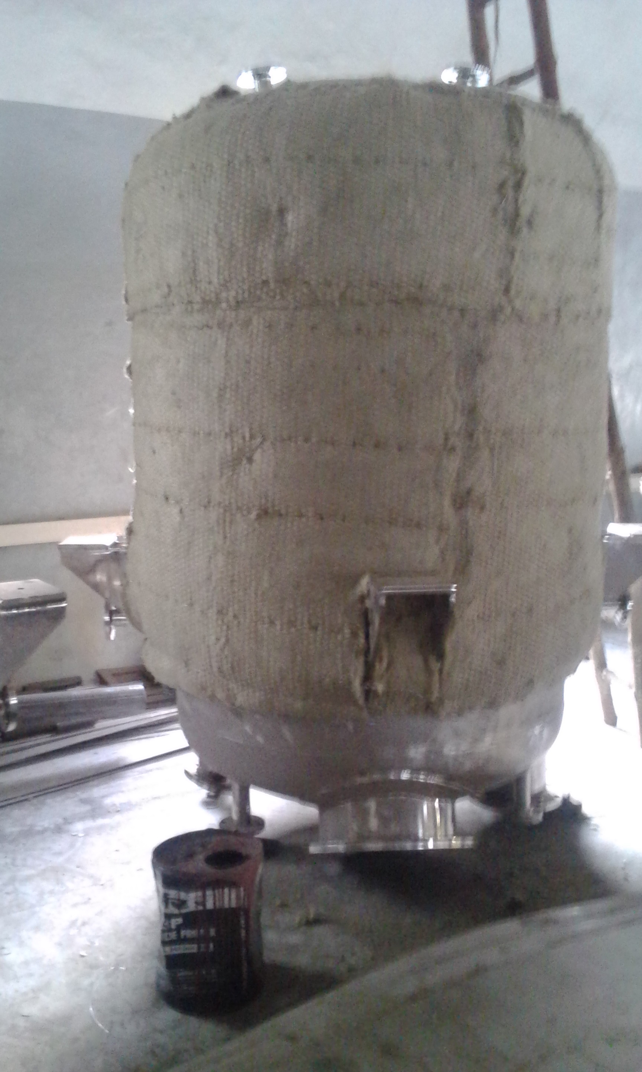
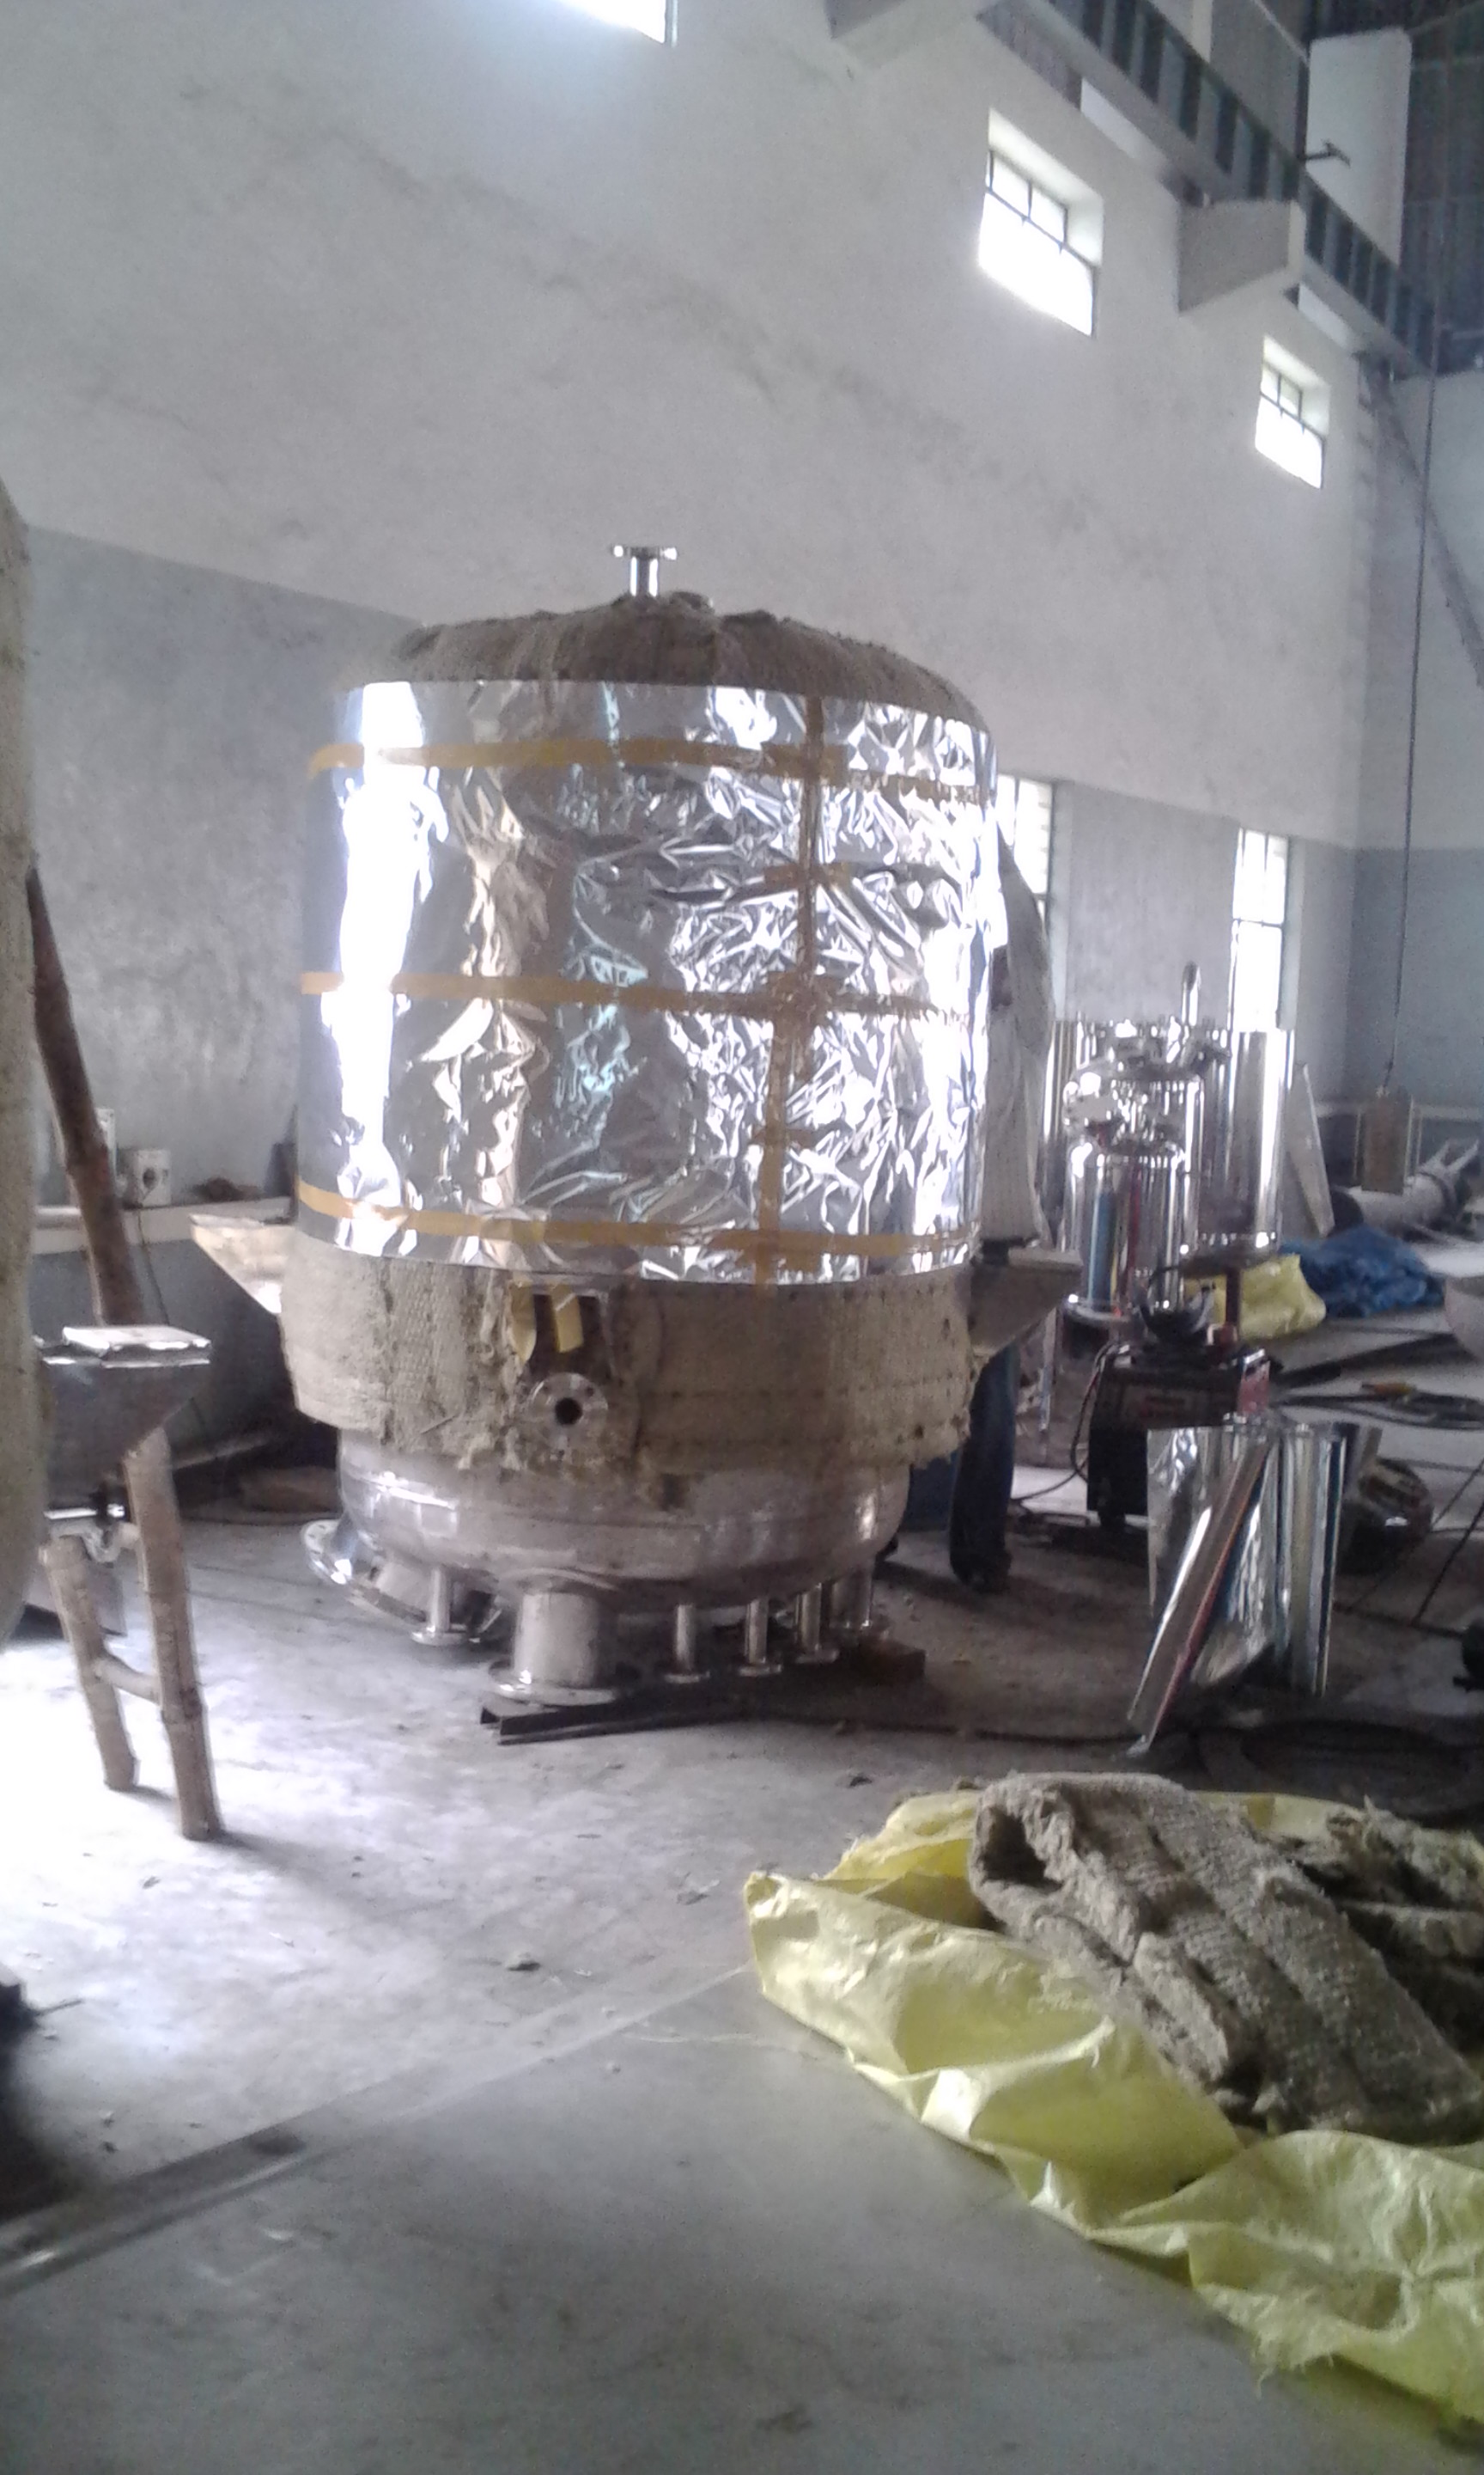
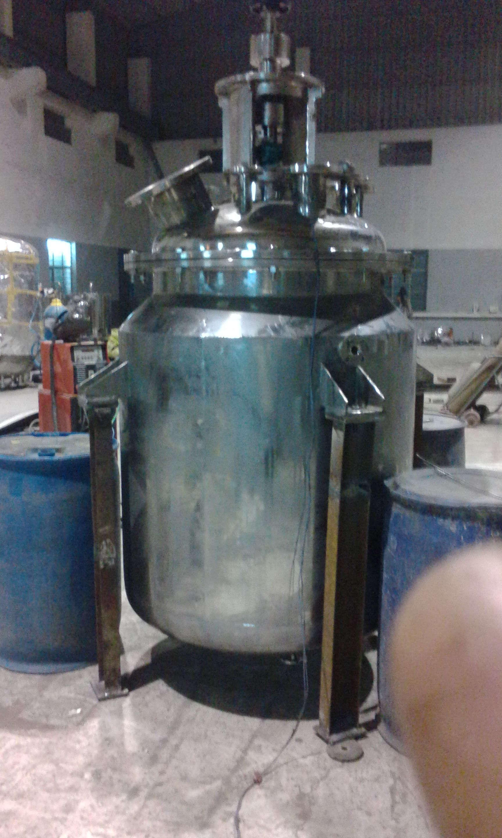
SRI LALITHA ENGINEERING

Slide 15
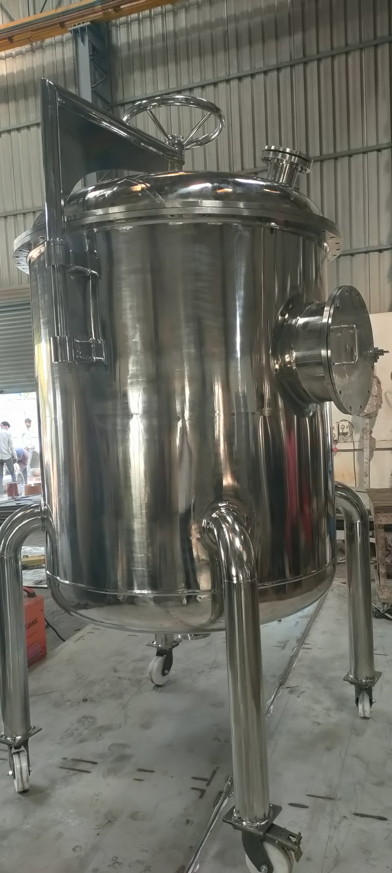
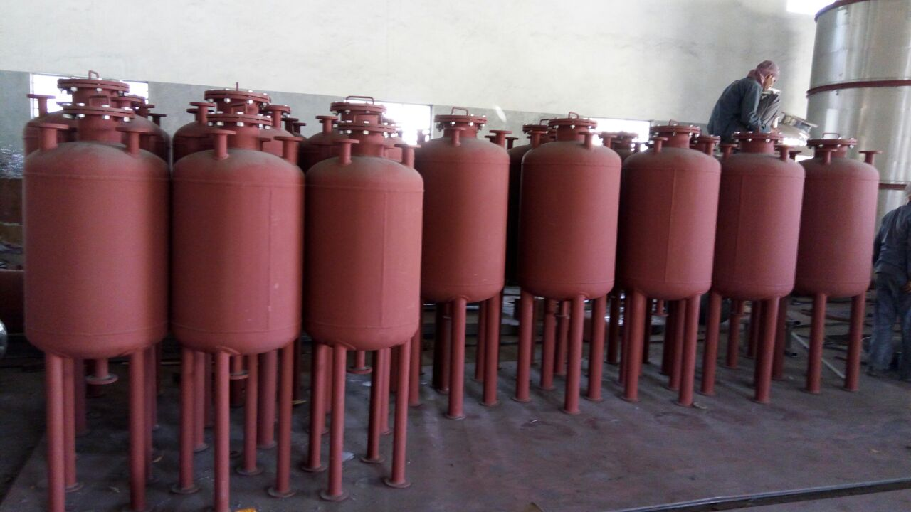
SRI LALITHA ENGINEERING

Slide 16
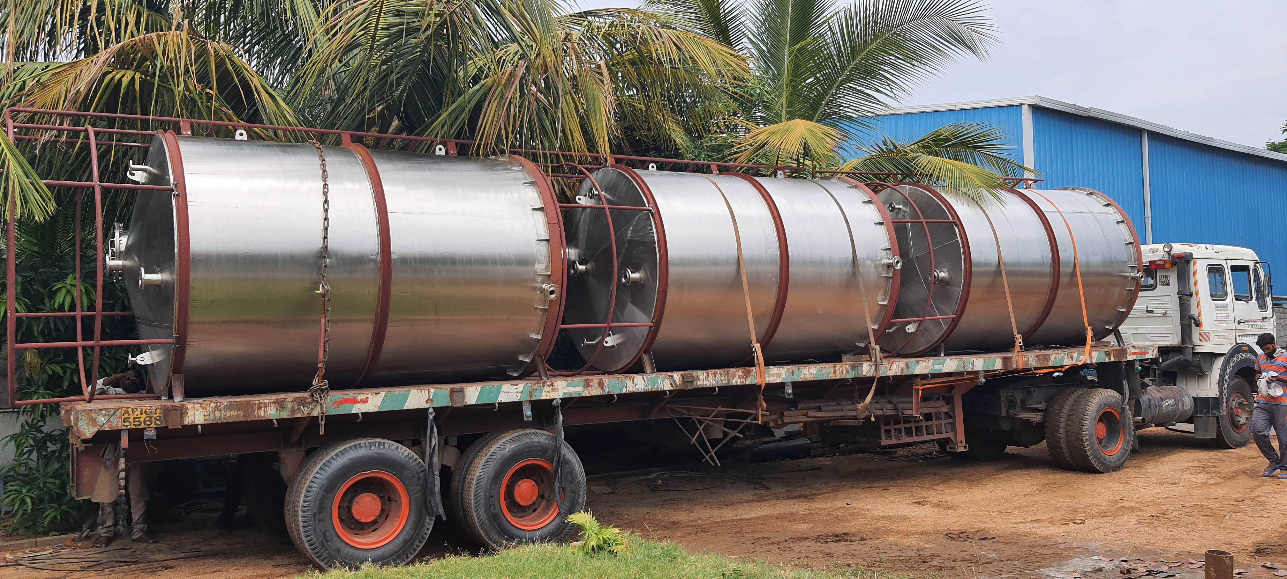
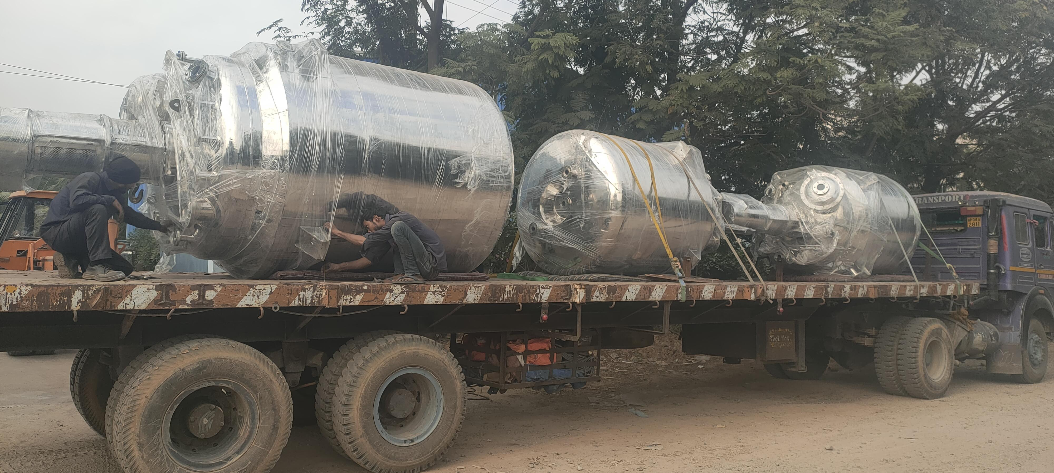
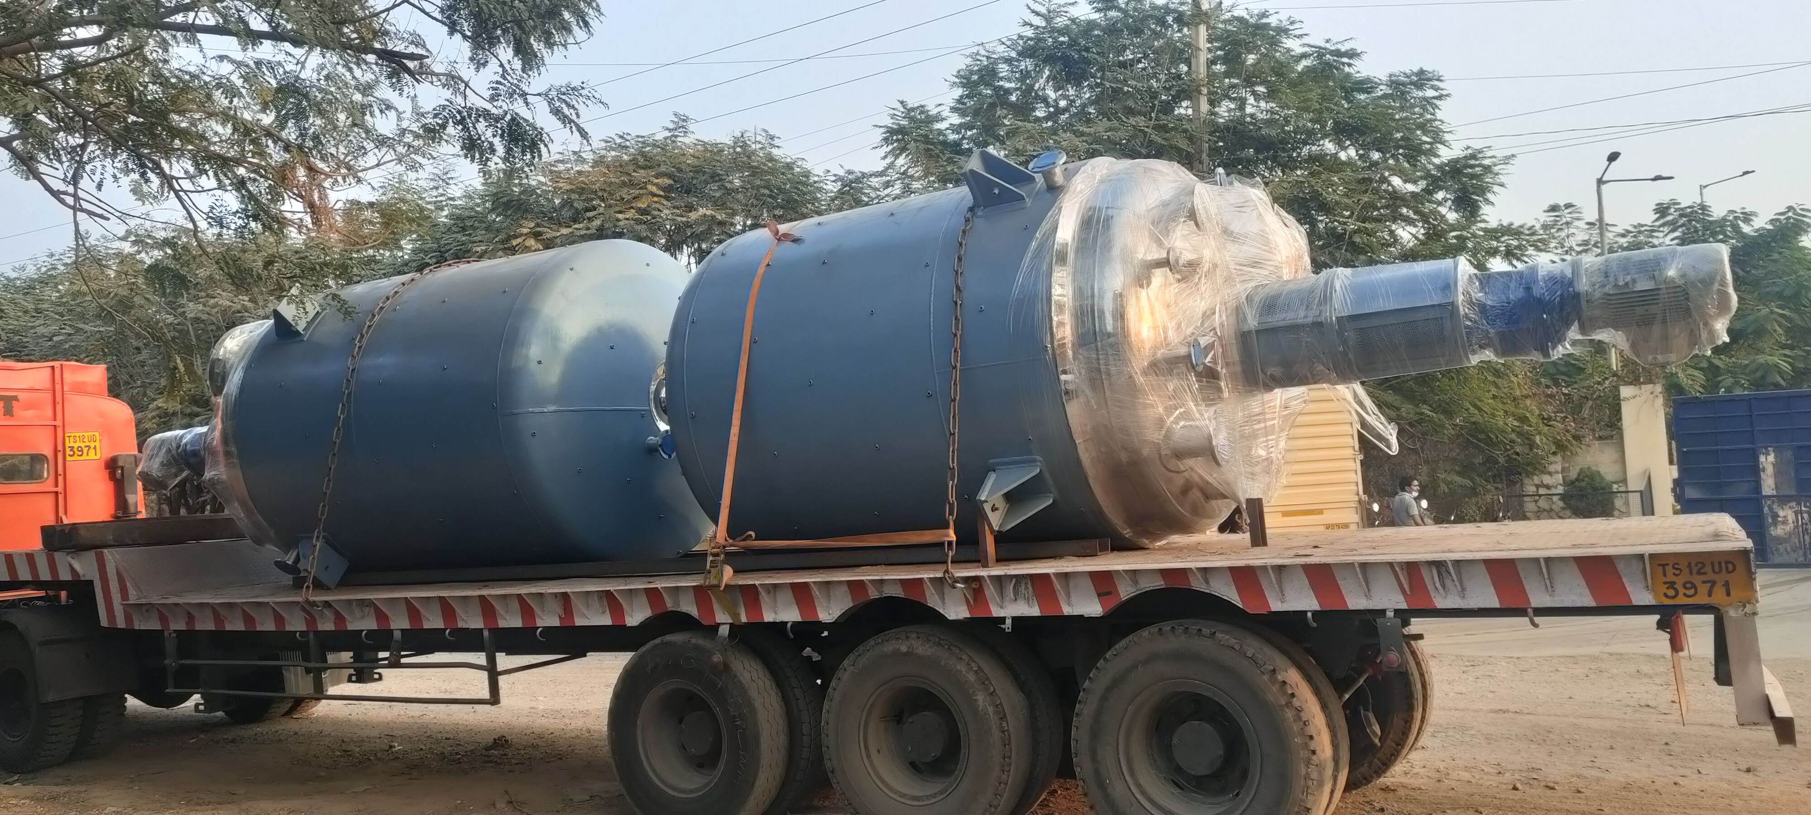
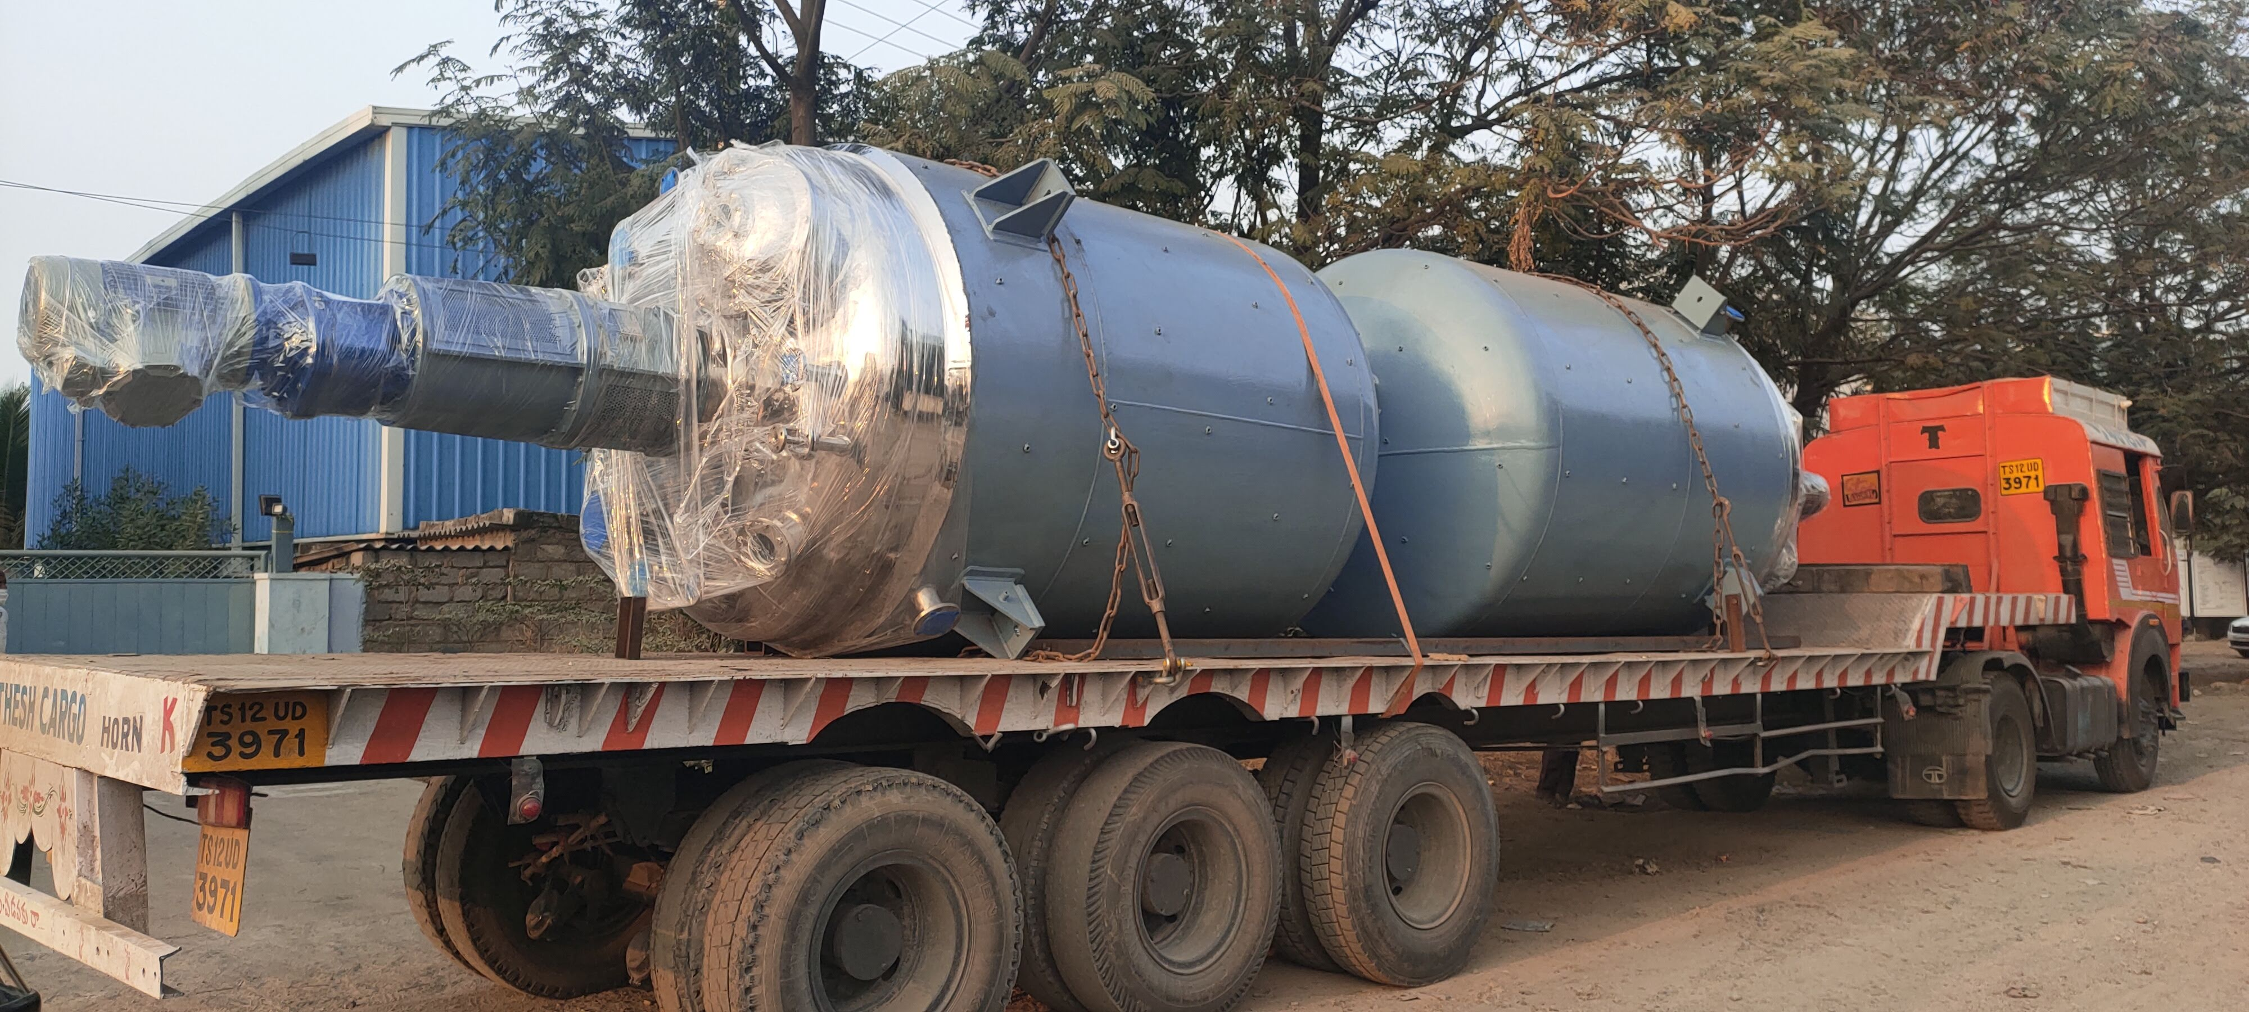
SRI LALITHA ENGINEERING

Slide 17
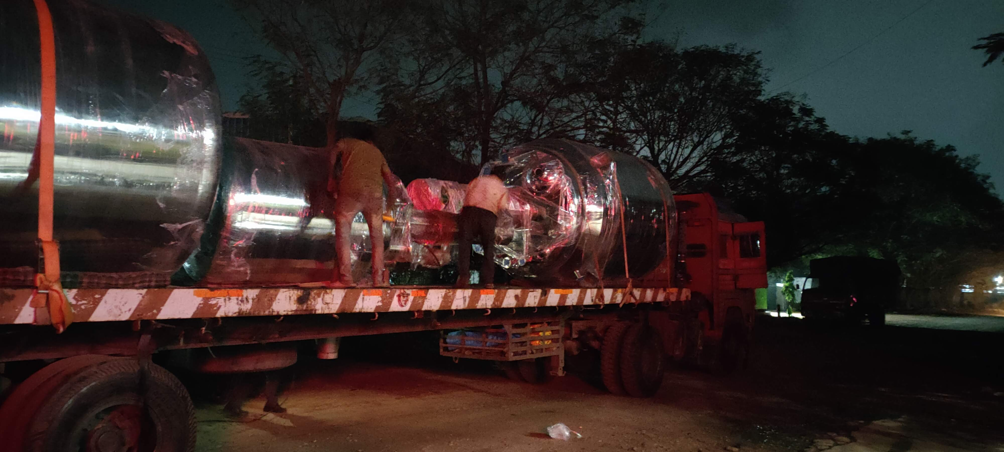
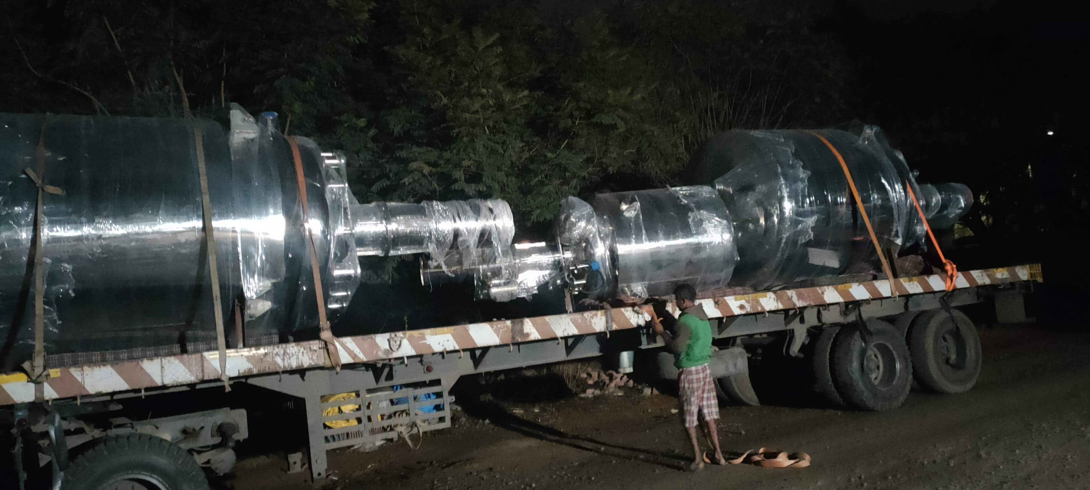
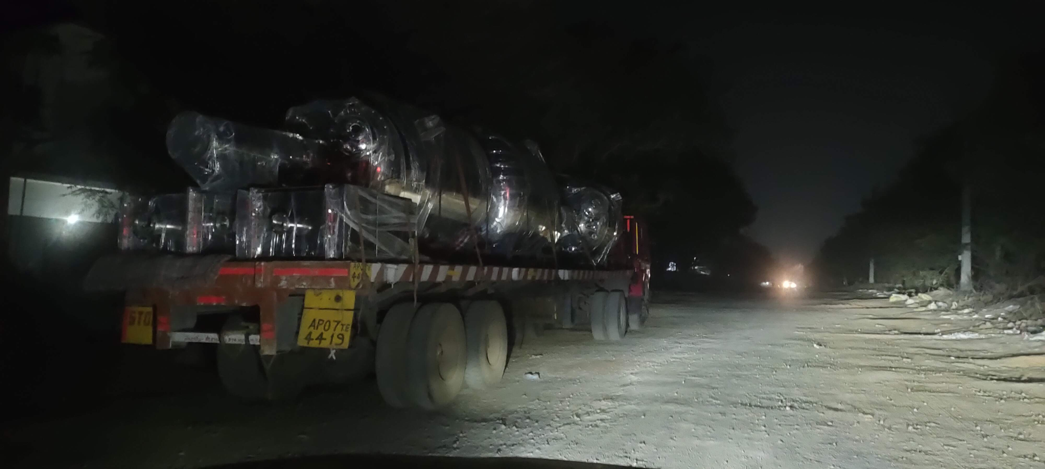
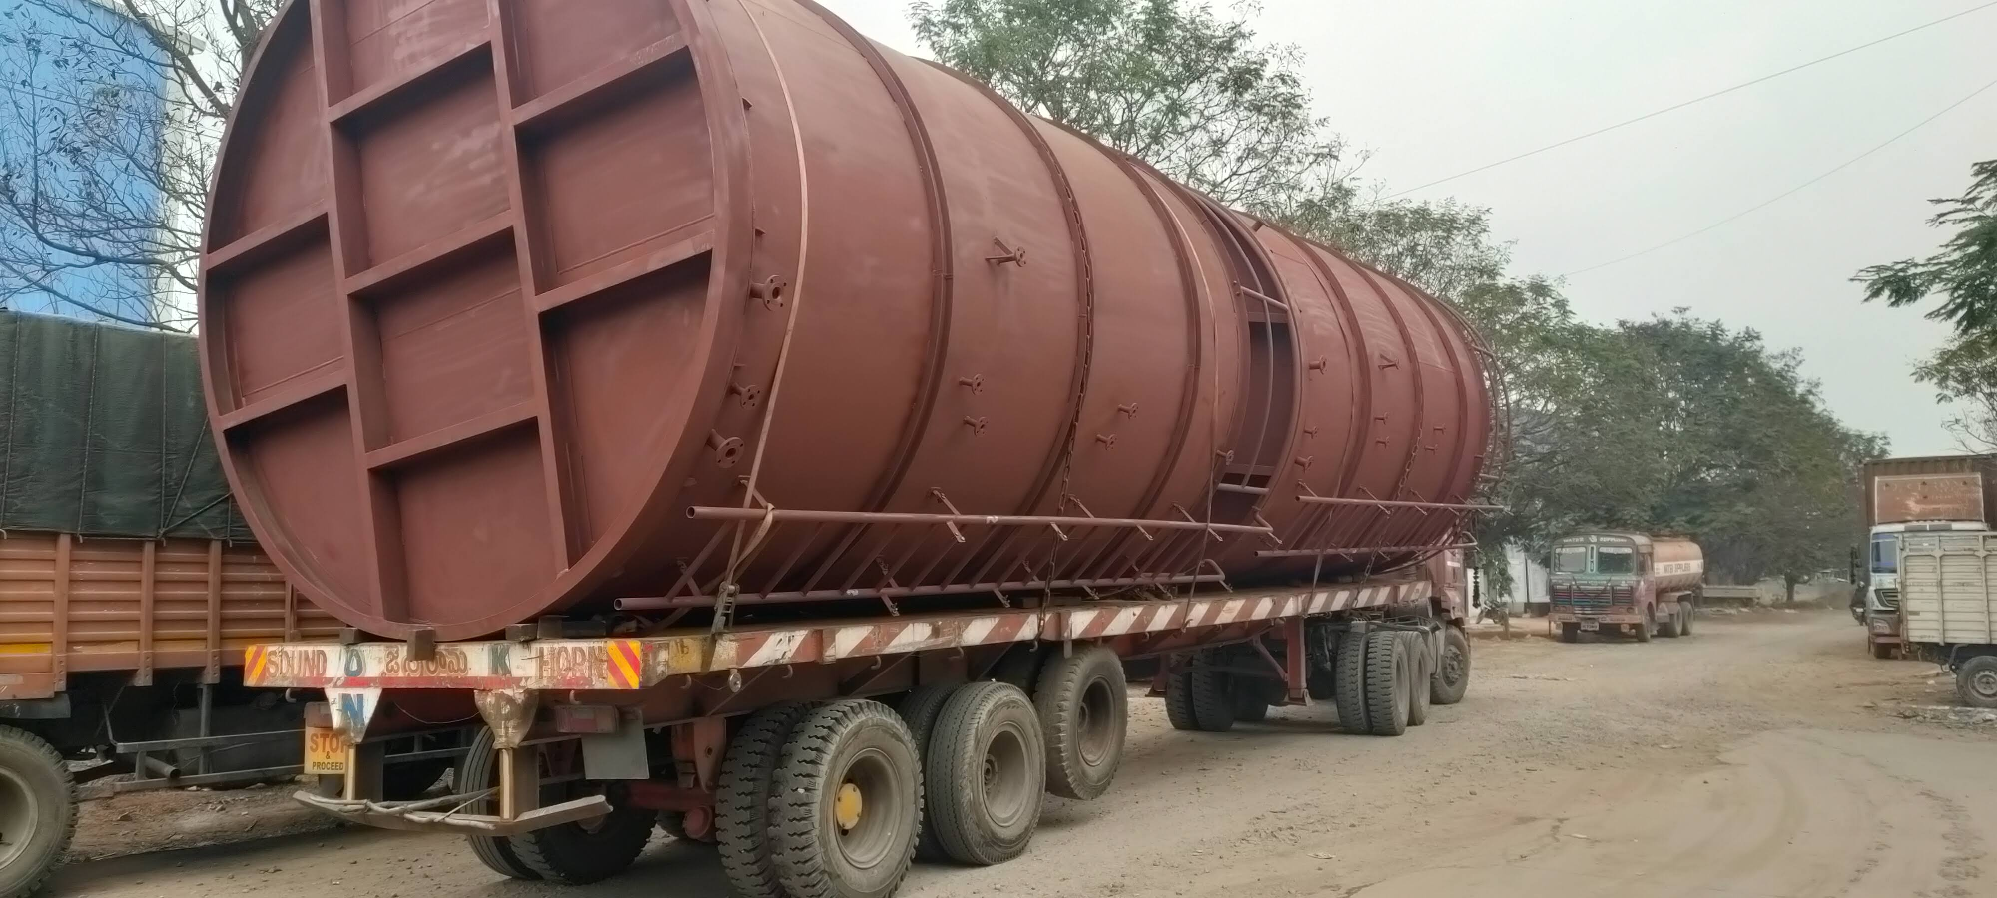
SRI LALITHA ENGINEERING

Slide 18
SRI LALITHA ENGINEERING
Thank you
RAMA RAJU - 9885713999
9989785588
Mail: srilalithaengineering1@gmail.com
SRI LALITHA ENGINEERING

